Slide 1
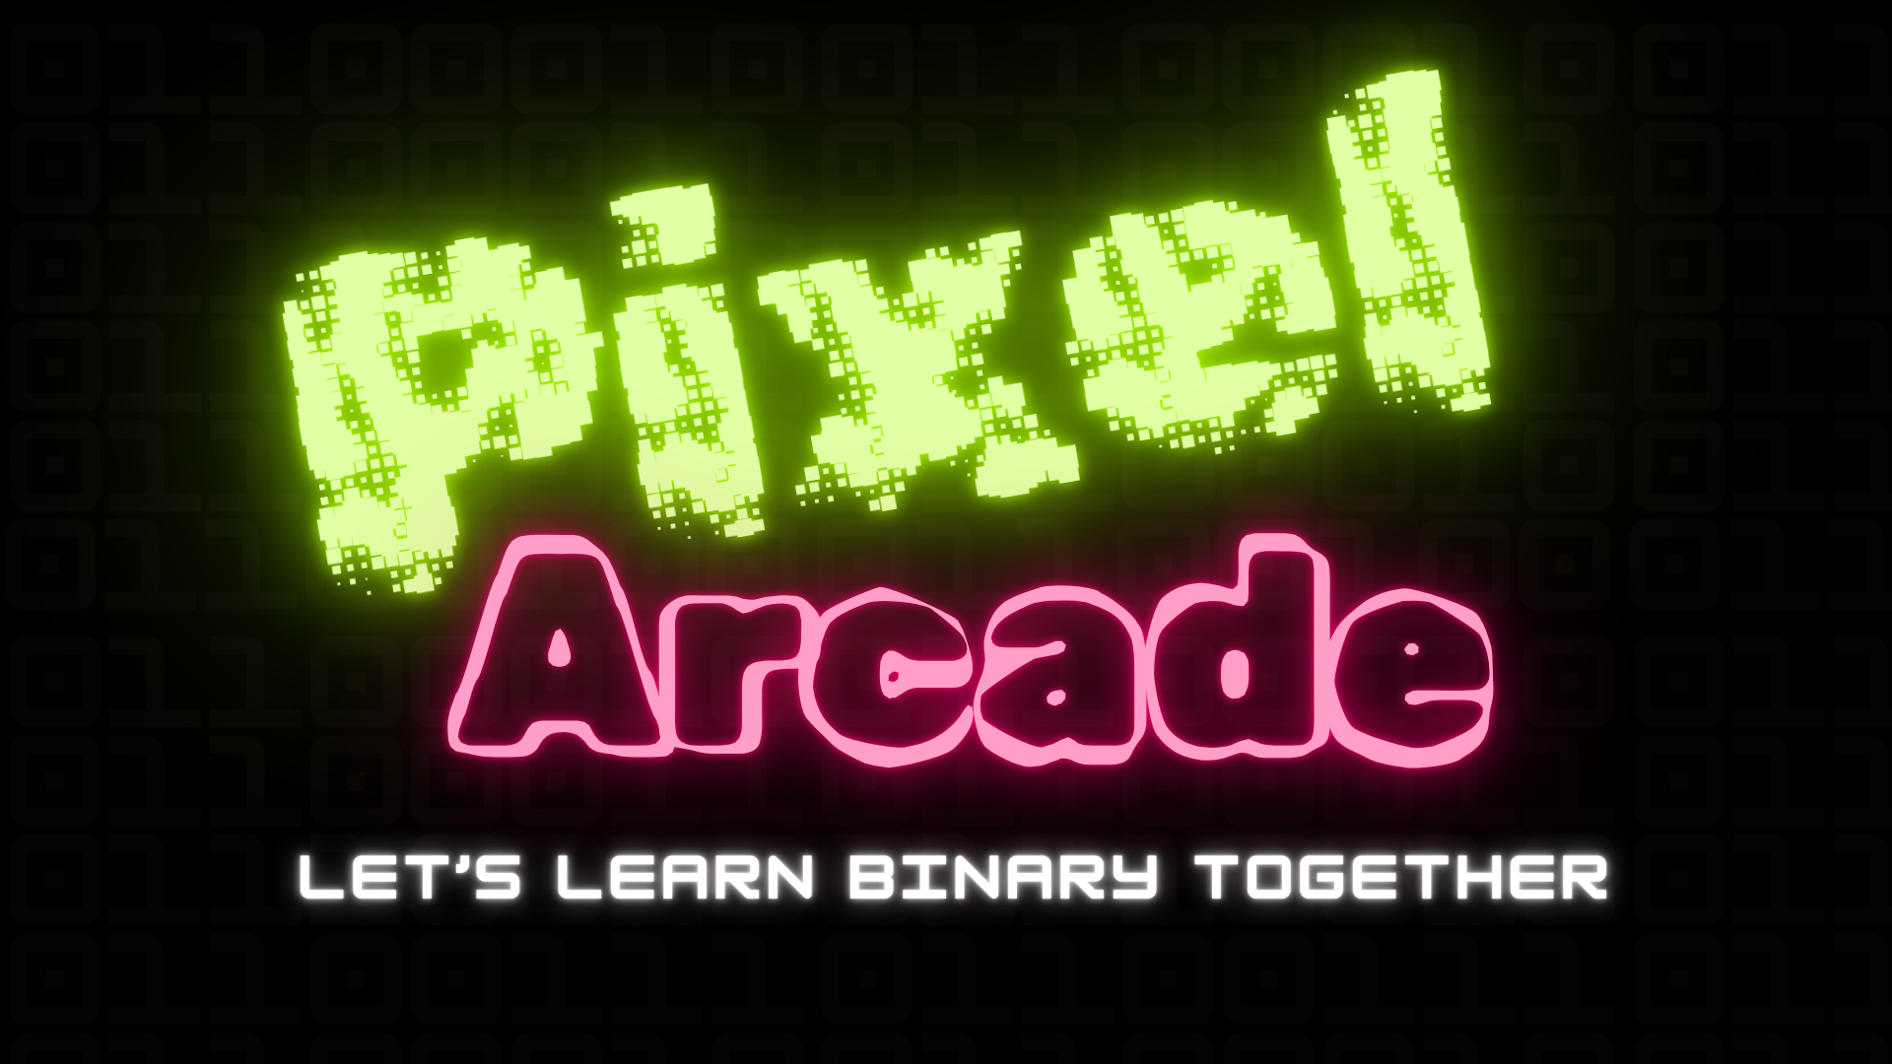
Shianne Lesure, Zuberi Thompson, Celeste Echols, Seohyeon Kim

Slide 2

What is TAP?
Technology Ambassador Program (TAP) is a project-based class that provides a collaborative environment for students to work with their classmates on a semester-long project using technologies of their choice. TAP strives to increase participation in IT through numerous outreach activities and workshops that are designed to showcase the creative and fun side of technology.
The goal of a TAP project is to create an interactive project that will engage and teach students about complex technology concepts but in a simple, easy to learn manner.

Slide 3
Goals
This project is geared towards middle school students up to college level students.
This study is being conducted to see if video games are a valid medium of instructing students on complex technical concepts. This study will also compare the effectiveness of in-person learning to online learning.
This project aims to be engaging for students so that they can learn binary thorugh active learning without a lot of stress.

Slide 4
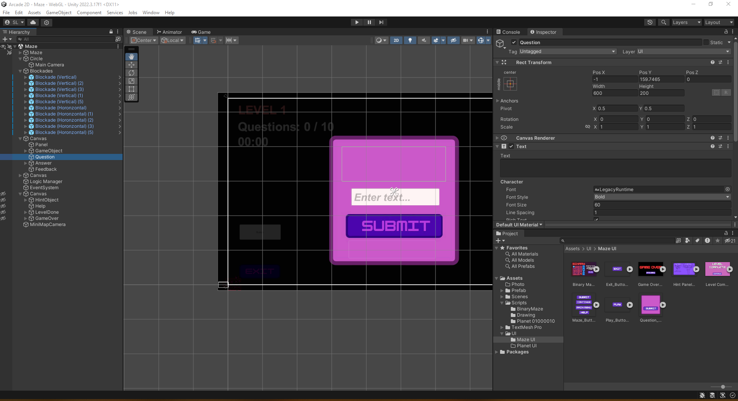
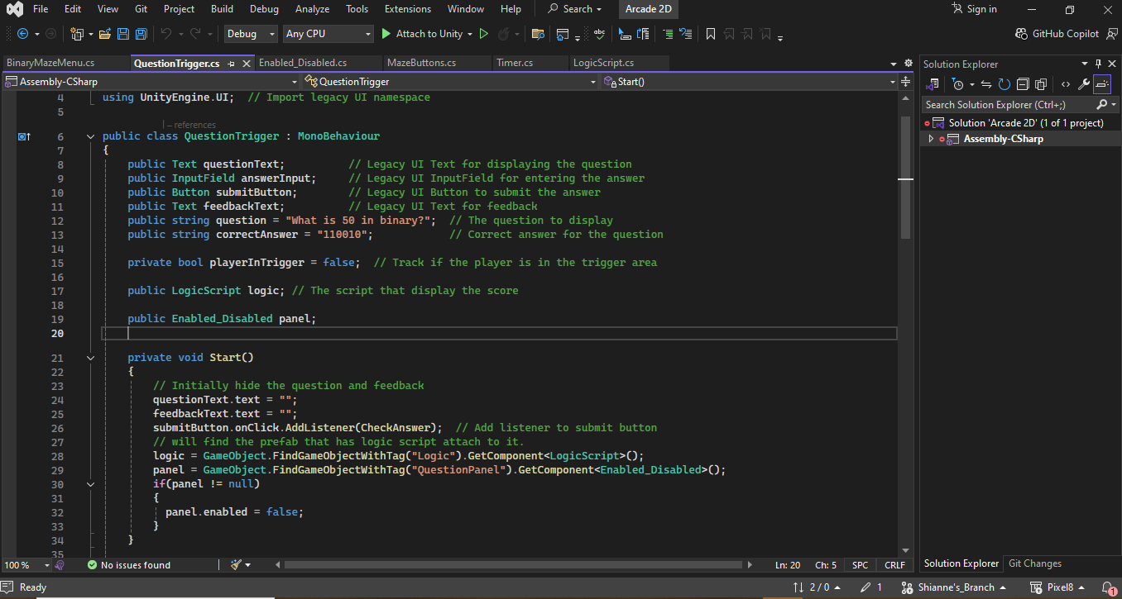

Project Description
The project is built with Unity as the main technology.
Unity is a popular cross-platform game engine used for developing 2D, 3D, AR, VR, and simulation-based projects.
This technology was used to build an interactive 2D game that will instruct participants about the basics of binary.

Slide 5
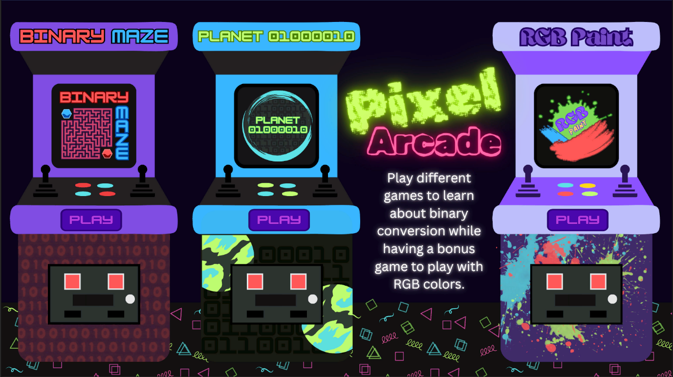
What is Pixel Arcade?
Pixel Arcade is an interactive 2D arcade game that will teach about the basics of binary through the 3 mini games at display.
Binary Maze
Planet 01000010
RGB Paint

Slide 6
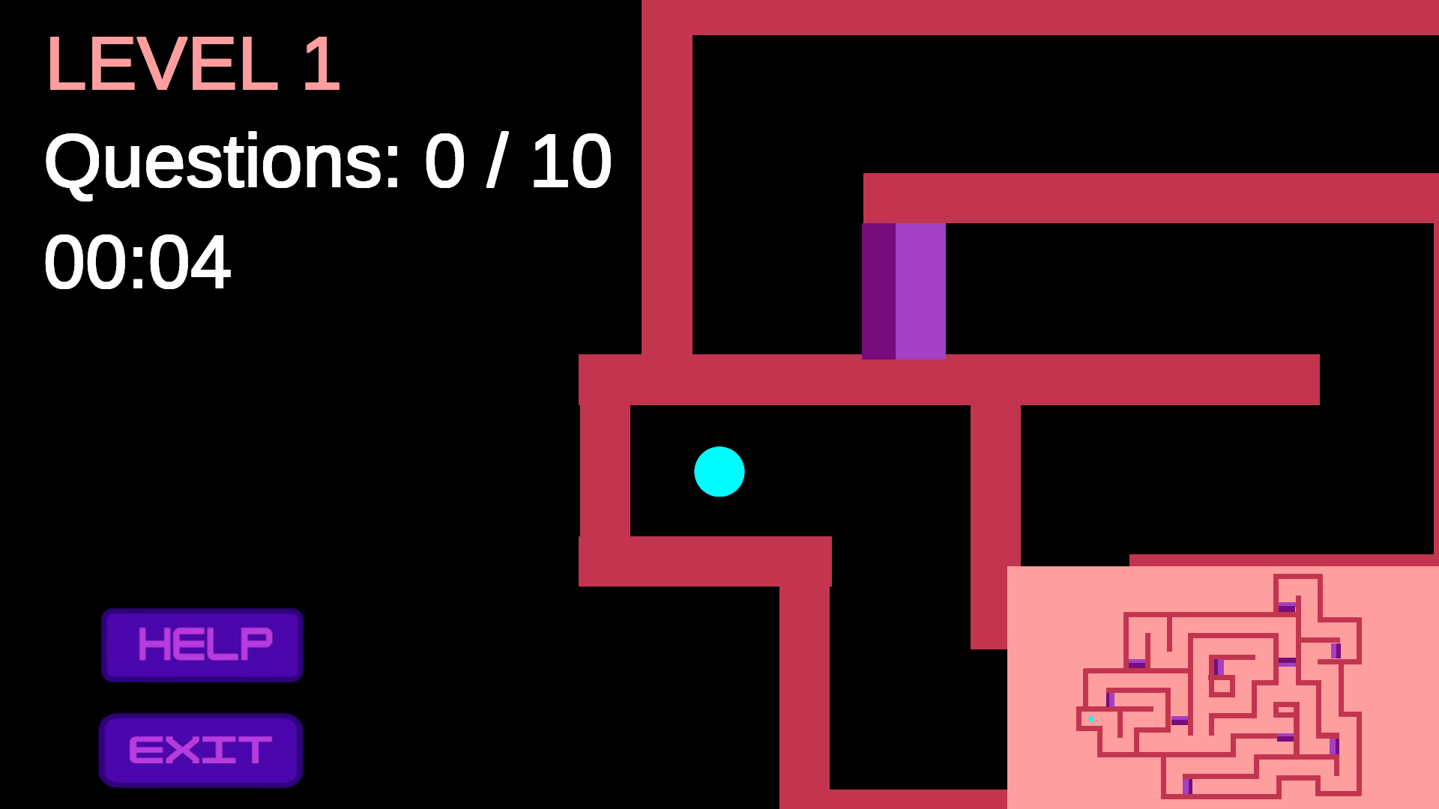
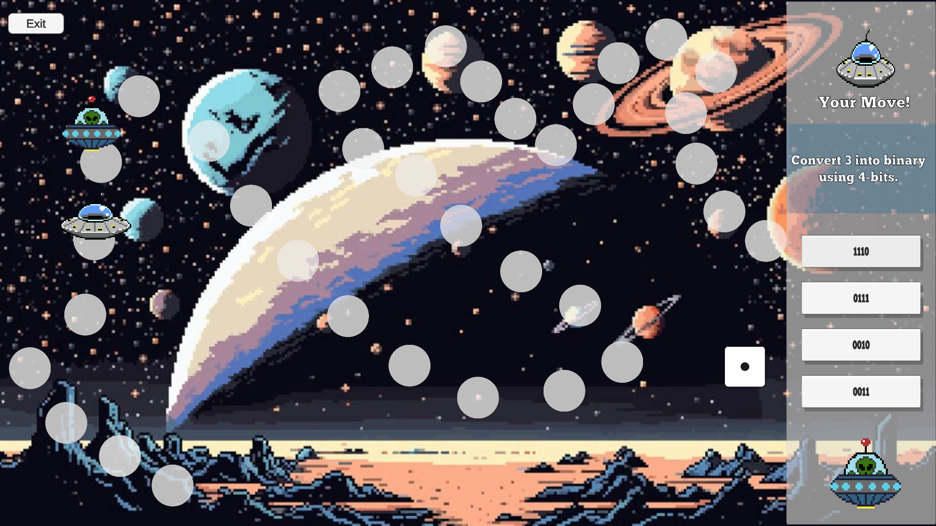
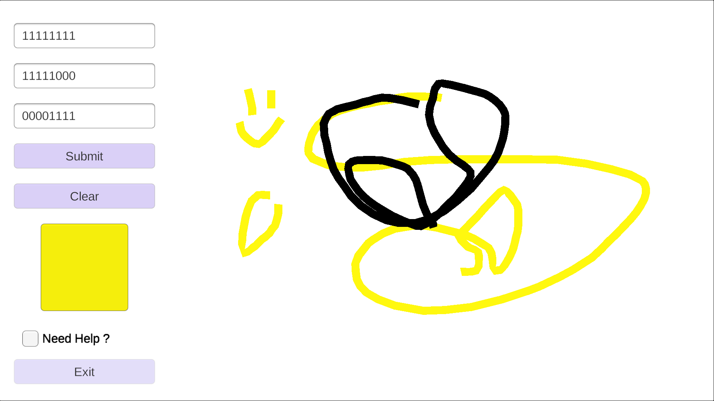
BINARY MAZE
PLANET 01000010
RGB PAINT
A 3-level game where the user goes through a maze and must answer all the questions before moving on to the next level.
A game where the users will answer questions about binary with varying difficulty to see if they can beat the NPC at traversing the board and get back home.
A game where the user will plug in some numbers for the RGB chart which will then produce a random color for them to draw with on their canvas. This will only open when you have at least played one of the games

Slide 7
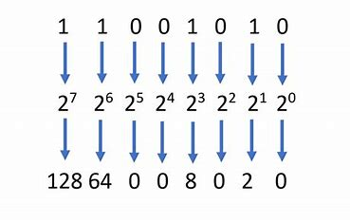
Introduction to Binary
Binary is a number system that uses only two digits:
0 and 1.
It’s the foundation of all computer systems.
Each binary digit is called a bit.
Example: Binary numbers like 101 represent values in the same way decimal numbers do but using only 0s and 1s.

Slide 8
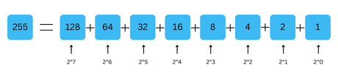
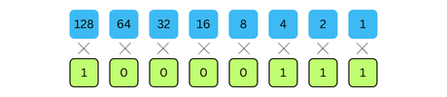
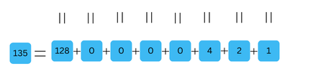
How Binary Works
Binary Place Values:
Each place in a binary number represents a power of 2.
Starting from the right, the first position is 202^020, then 212^121, 222^222, and so on.
Example: The binary number 101 equals:
(1×2^2)+(0×2^1)+(1×2^0)=4+0+1=5
Example:

Slide 9
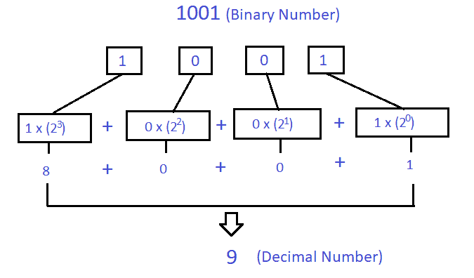
Converting Decimal to Binary
To convert a decimal number to binary:
Find the highest power of 2 that fits into the number.
Subtract that value and repeat for the remainder.
Example:
Convert 13 to binary:
2^3 = 8 so 13 - 8 = 5 → 1 in the 8's place. (1000)
2^2 = 42 so 5 - 4 = 1 → 1 in the 4's place. (100)
2^1 = 2, 2 > 1 so 1 - 0 → 0 in the 2's place. (00)
2^0 = 1 so 1 - 1 = 0 → 1 in the 1's place. (1)
13 in binary = 1101

Slide 10
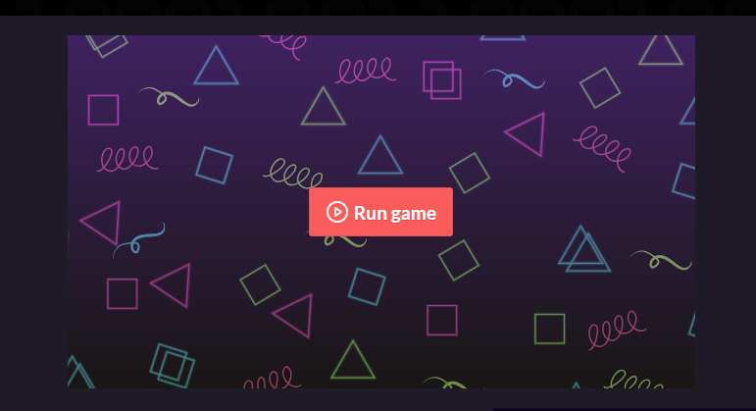
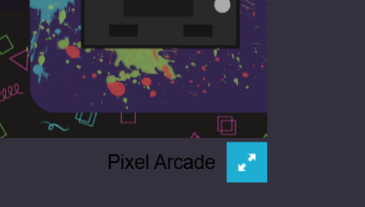
Workshop Description
Go to https://slesure.itch.io/pixel-arcade.
Read the description under the game to understand the details.
When you're ready to play, click the "Run game" button.
Once the game loads, hit the full screen icon at the bottom right corner of the game view for the best experience.
Start by playing the assigned game.
If you finish early, feel free to explore and play the RGB paint game.

Slide 11
Please fill out the survey and give us as much feedback as possible so we can improve in the future~!

Slide 12
Questions?

Slide 13


